Slide 1
How to develop and communicate
a research vision
Chris Barrett, Cornell University
AgEcon Meet 185th EAAE seminar on
Early Career Development of Agricultural Economists in Europe
Göttingen, Germany
October 6, 2022

Slide 2
What is a research vision?
3 core questions to keep asking yourself. This never ends.
1. What is your passion? Life’s short. Do research that excites you.
2. Where can you make an impact? Research is hard. And we’re all deeply privileged. Make sure your efforts pay off for others.
3. What’s your comparative advantage? Specialize and/or collaborate, as appropriate to your individual circumstances.
The answers to those three questions define your research vision.

Slide 3
Then what? Stochastic dynamic programming!!!
Once you answer those three questions, recognize that …
Research management is a stochastic DP: Use backward induction (you knew there was some reason you took macro! ☺ )
- Where do you want to be post-promotion to Full Professor?
- Know the difference between the control and state variables
- Be prepared to adapt to stochastic events.
- Understand the time lags between inputs and payoffs
- Is there a natural sequence or simultaneity to actions?

Slide 4
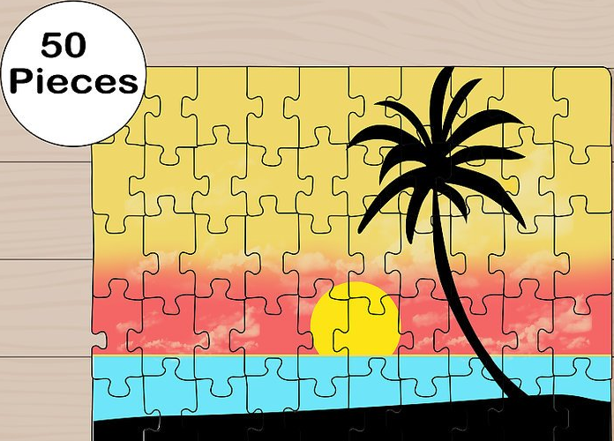
A research program is like a jigsaw puzzle
Start with your research vision, simply described …
Image: wikihow.com
Mine: “help reduce unnecessary human suffering”
Lucie Maruejols: “Implications of energy transition for the food sector and rural communities” … AWESOME!

Slide 5
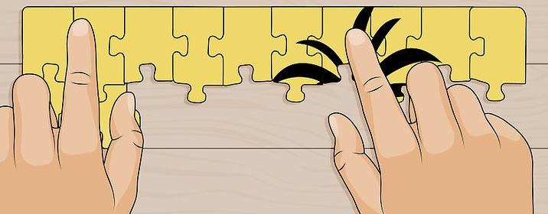
A research program is like a jigsaw puzzle
Tackle pieces strategically (e.g., define boundaries, make obvious connections right away, don’t sweat temporary blank spaces)
Image: wikihow.com
It may not be obvious to others what the broader vision is.
So explain how pieces fit together in general, simple terms.
Then provide more detail on how specific papers/projects fit into the big picture.

Slide 6
The research statement
Just like your cv …
Update regularly. Always have a current research statement.
Provide a brief summary of the most important takeaways first. Then go into the details.
You don’t need to fit in absolutely everything you ever did.
Make it easy to read – enough white space, big enough font, etc.
Pay careful attention to details – sloppiness in small, obvious things suggests there’s sloppiness in bigger, less obvious ones

Slide 7
A research program is like a jigsaw puzzle
It’s often most fun to do puzzles with others ☺
Ultimately, you frame and keep some puzzles, give others away.
Done right, the process means as much as the product.
Image: CNBC.com

Slide 8
I hope this is helpful.
Enjoy the process of reflecting on, pursuing and regularly adapting
your research vision

